Slide 1

PhD Supervisors Meeting
xx/xx/24

Slide 2

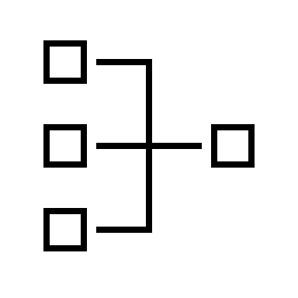

Agenda
REFINED RESEARCH
QUESTIONS
SYSTEM GRAPHIC
ARTICLE SEARCHES

Slide 3
Exploring Research Questions

Slide 4
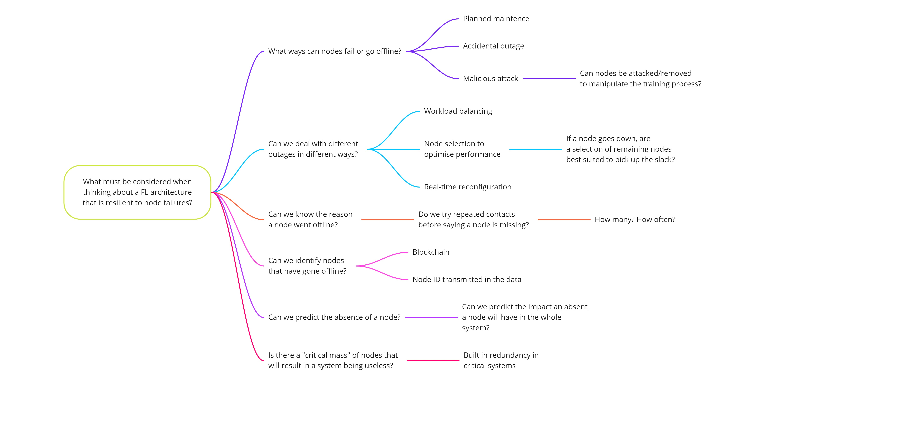
Research Question 1
In any large distributed network, there is a chance that some nodes can be lost, for a range of reason. Can a FL architecture be designed to be resilient, allowing it to identify missing nodes, and adapt so that there is no loss in performance?

Slide 5
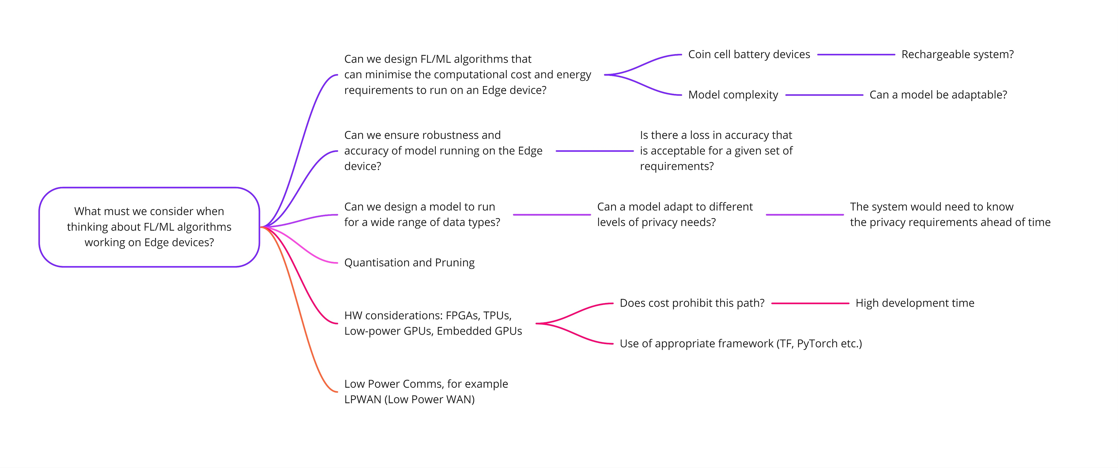
Research Question 2
With the ever-increasing use of IoT devices, can FL algorithms or tools be designed to operate specifically on Edge devices to minimize computational and costs. The models should be adaptable to a range of data sources and types.

Slide 6
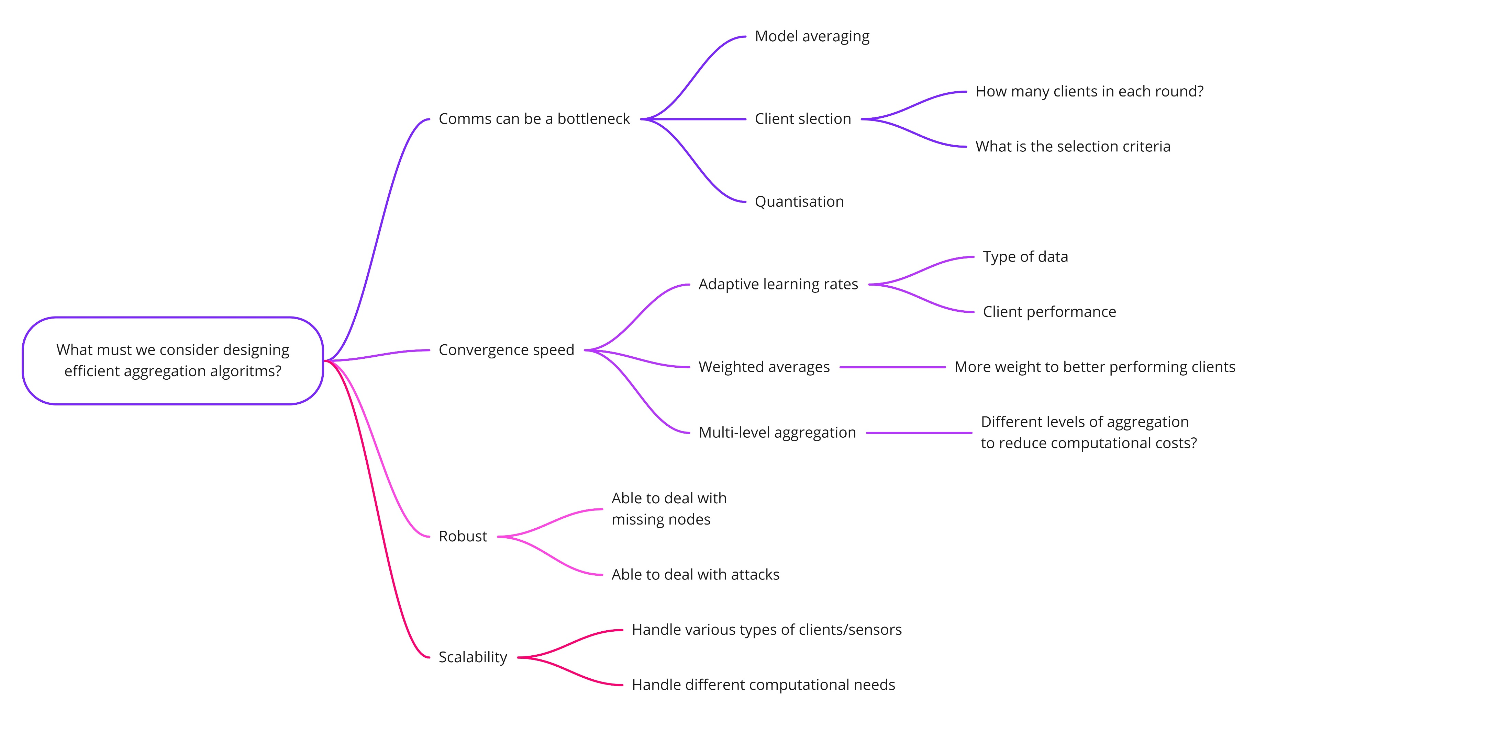
Research Question 3
Can we design efficient aggregation algorithms for FL that minimize the data exchange between clients and servers while not reducing the model accuracy?

Slide 7
Research Questions
Research Question 3

Slide 8
Research Questions
Research Question 1
In any large distributed network, there is a chance that some nodes can be lost, for a range of reason. Can a FL architecture be designed to be resilient, allowing it to identify missing nodes, and adapt so that there is no loss in performance?
Research Question 2
With the ever-increasing use of IoT devices, can FL algorithms or tools be designed to operate specifically on resources Edge devices to minimize computational and communications costs. The models should be adaptable to non independently and identically distributed data (IID), and ideally be carried out on the device.
Research Question 3
Can we design efficient aggregation algorithms for FL that minimize the data exchange between clients and servers while not reducing the model accuracy?
When thinking about robust and resilient FL systems, can blockchain

Slide 9
Backup

